Slide 1
ADVERSE EFFECTS FOR MENTAL HEALTH MEDICATIONS
GROUP-8
JHANSI BALLA
11801681

Slide 2
OVERVIEW
DRUG SEARCH
CLEANING DATA
GROUPING
SEGREGATION
SORTING DATA
NORMALIZATION

Slide 3
Introduction
The purpose of this study is to identify the significant differences in adverse outcomes between males and females. And to explore the adverse effects of mental health medications and their implications for overall well-being .

Slide 4
DRUG SEARCH
A database for tracking medication safety and side effects is the FDA Adverse Event Reporting System((FEARS).
We can access the data from the above mentioned database.
Navigate to the FEARS dashboard and specify the drug name in the search bar.
3. Apply filters like date and explore the outcomes related to the drug.
4. Find the download button on the dashboard and select the preferred format like csv file or pdf file .
5. If there are filters available, select them to obtain just relevant data.

Slide 5
DATA CLEANING
Data cleaning is the process of identifying , fixing and eliminating mistakes and inconsistencies in datasets to make sure that the data is accurate , trusted and of high quality for analysis and decision making.
It reduces the time spent troubleshooting errors during analysis.
The data I used had duplicates , missing data and irrelevant data after data cleaning I resolved these issues.

Slide 6
AGE GROUPING
I have categorized the data according to the ages of the patients, and arranged them into various groups.
The ages are categorized into groups like 0-6, 7-12, 13-21, 22-40, 41-60, 61-80, 81+.
This approach is especially useful for healthcare analysis or any domain requiring segmentation of data based on age ranges.

Slide 7
SEGREGATION
In this step, I have done segregation of adverse effects based on age and sex.
By breaking down the data into male and female categories for each pre-defined age group, this approach ensures a detailed examination of gender-specific trends.

Slide 8
SORTING DATA
Sorting data is the crucial step in the data analysis.
I have used Gemini, a large language model , to automatically categorize the adverse reactions into designated organ system.
This classification provides a clear understanding of which organ systems are primarily affected by the reactions for each age group and sex.

Slide 9
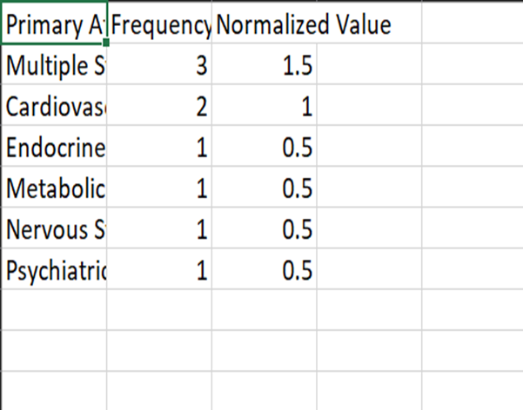
NORMALIZATION
Normalization removes differences among various datasets, creating an equal basis for comparing reaction frequencies across gender, age groups and organ systems.
It makes things easier to evaluate and compare the relative impact of different organ systems, regardless of the scale or distribution of the raw data.

Slide 10
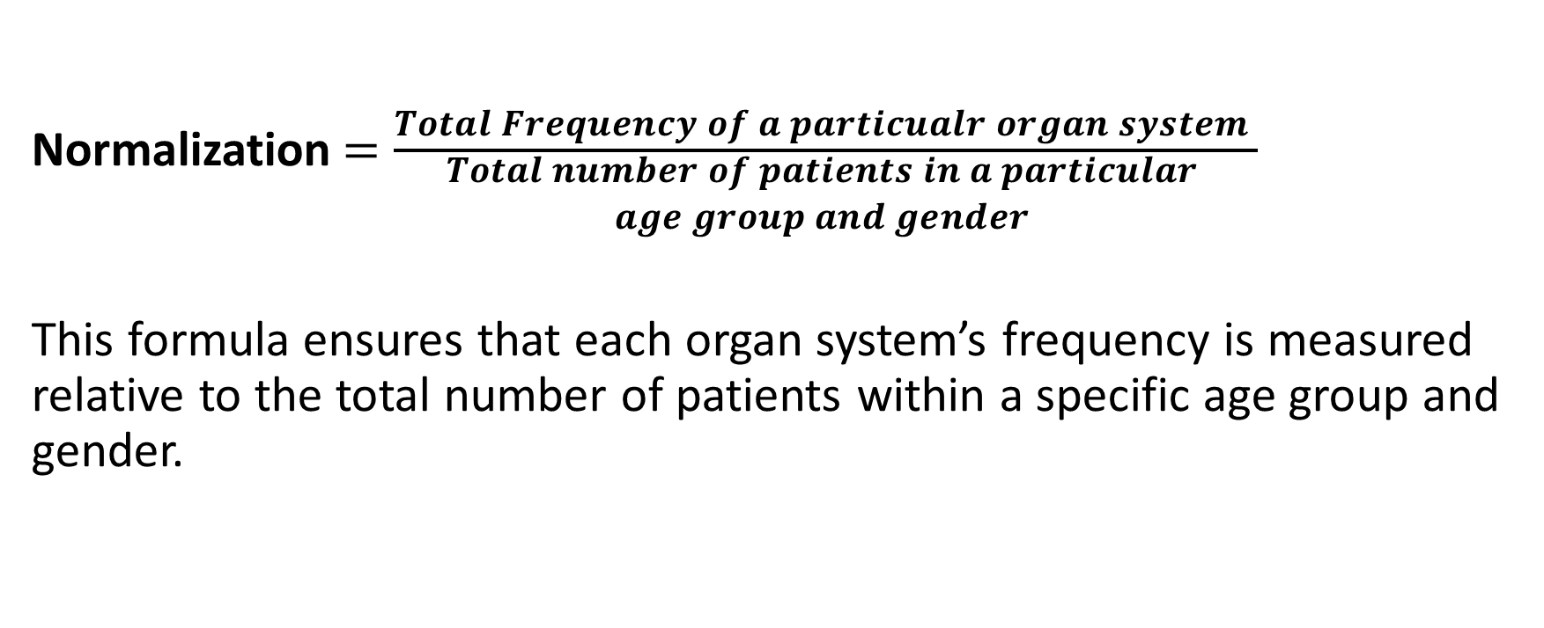
NORMALIZATION
Normalization$=\frac{Total Frequency of a particualr organ system }{\begin{aligned}Total number of patients in a particular \\ age group and gender \\ \\ \end{aligned}}$
This formula ensures that each organ system’s frequency is measured relative to the total number of patients within a specific age group and gender.

Slide 11
PLOTTING GRAPHS
BUSPIRONE
CARBAMAZEPINE
VALPROIC

Slide 16
BUSPIRONE

Slide 17
Notes:
The graph indicates gender-specific trends in organ system for 13-21 age group with males being more affected by cardiovascular and nervous system issues, while females show a higher tendency toward multi-system involvement.

Slide 18
Notes:
This bar graph indicates the top three affected organ systems for males and females aged 22–35, based on normalized values. Females show a higher tendency for multi-system involvement while males are highly affected with nervous system issues.

Slide 19
Notes:
This bar graph highlights the top three affected organ systems for males and females aged 36–50. Musculoskeletal issues affect both genders equally. Nervous system issues are most prevalent in males, followed closely by females.

Slide 20
Notes:
This bar graph indicates the top 3 affected organs for age group 51-60 for males and females. Nervous system issues are more in females. Gastrointestinal issues are found only in females .

Slide 21
Notes:
This bar graph indicates the top 3 affected organs for age group 61-80 for males and females. This age group has similar issues for both males and females.

Slide 22
Notes:
This bar graph indicates the top 3 affected organs for age group 81+for males and females. Endocrine and multiple system involvement are more affected for females in this age group. Nervous system issues are found only in males.

Slide 23
Thanks!

